Slide 1
Product Authentication and Counterfeit Elimination Using Blockchain Technology
Team Details:
K VijaySimha (20EG105421)
R Chandravikas (20EG105438)
T SaiKumar (20EG105445)
Project Supervisor:
Dr B.V.V.Siva Prasad
Associate Professor

Slide 2
Introduction
A system focused on product authentication and counterfeit elimination using blockchain technology.
A system designed to record a product's journey from its manufacturing stage to the end customer. This system ensures that customers can verify the authenticity of the product and guards against counterfeit scans.
We requires a robust system that can track the product's pathway and assure customers that the scans are genuine.
These application extends to product authentication and anti-counterfeiting across various industries. Specifically, it enables manufacturers to prove the authenticity of their products, strengthens supply chain transparency, and minimizes the risk of financial and reputation loss resulting from counterfeit products.

Slide 3
Problem Statement
Existing challenges related to product authentication and counterfeit elimination are : we reliance on traditional product authentication systems, often involving third parties, presents vulnerabilities to counterfeiting and fraud, jeopardizing both economic stability and consumer safety.
Counterfeiting Impact: Counterfeiting poses substantial economic and safety risks across industries, with an estimated $4.2 trillion loss and 5.4 million legitimate jobs at risk by 2022 in the global economy. In the pharmaceutical industry alone, counterfeit medicines valued at $75 billion annually contribute to approximately 1 million deaths per year, growing twice as fast as legitimate pharmaceuticals.
The problem of counterfeit products infiltrating the market is compounded by the risks posed, especially in critical industries such as pharmaceuticals, luxury goods, electronics, and food. The prevalence of counterfeits not only leads to economic repercussions but also jeopardizes consumer health and safety. The limitations of the existing systems in verifying product authenticity open opportunities for counterfeiters to exploit vulnerabilities, further exacerbating these challenges.

Slide 4
Proposed Method
Implementation of Blockchain Technology:
Decentralized Product Authentication ( Utilize blockchain to create a transparent and immutable ledger of product information, ensuring that consumers can easily verify the authenticity of a product before purchase.)
Supply Chain Tracking (Implement blockchain to track the entire supply chain process, from manufacturing to distribution.)
Usage of Unique Identifiers like QR Codes (linked to blockchain, which are challenging for counterfeiters to replicate.)

Slide 5
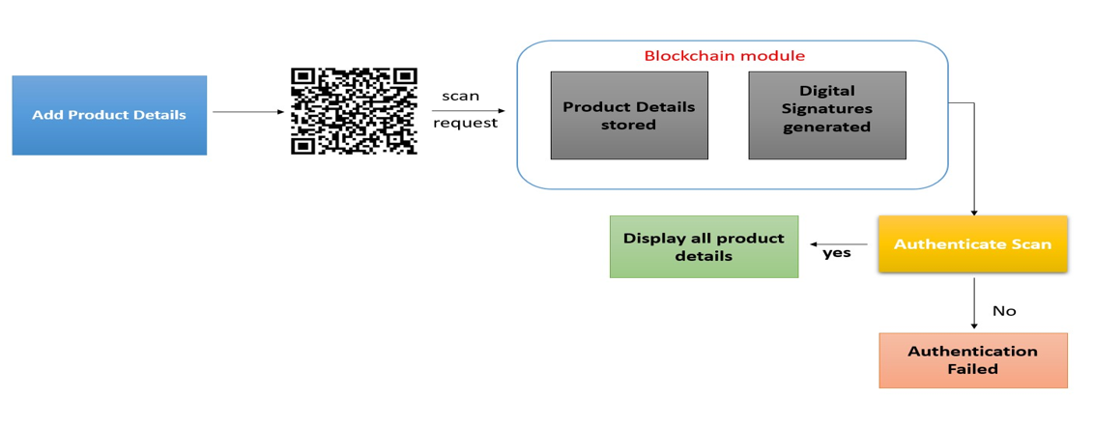
Proposed Method
To avoid forge counterfeit we are converting all product details into digital signatures and this digital signatures(unique hash code) will be stored in blockchain server which supports tamper proof data storage and nobody can alter data . If its data alter verification get failed and user get intimation about data alter.

Slide 6
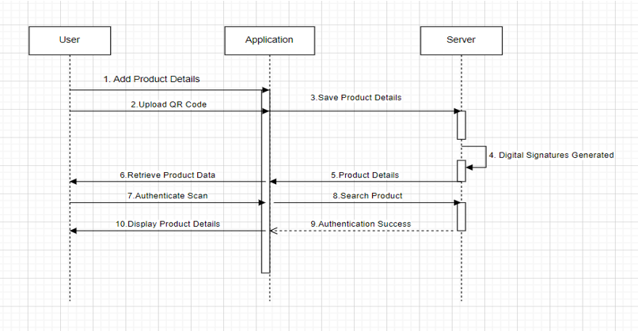
Proposed Method
Implementing Product Authentication Using Blockchain Technology :
1. Utilize Blockchain for Transparency
2. Incorporate Unique Identifiers
3. Track Supply Chain with Blockchain
4. Educate Consumers
5. Secure Packaging and Tamper-Proof Features
6. Conduct Regular Audits and Inspections
7. Collaborate with Stakeholders

Slide 7
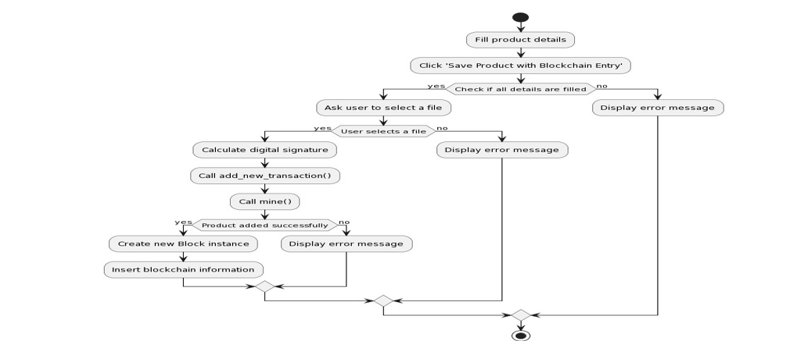
Proposed Method

Slide 8
Experiment Environment
Operating Systems Supported : Windows Based Operating System
Languages and Technologies Used : Python and Blockchain
Processor : Intel i5 or higher
RAM : 8GB
Hard Disk : 512GB

Slide 9
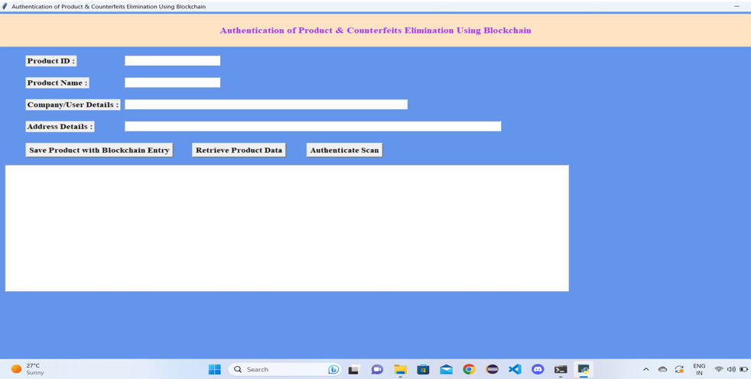
Experiment Screen shorts

Slide 10
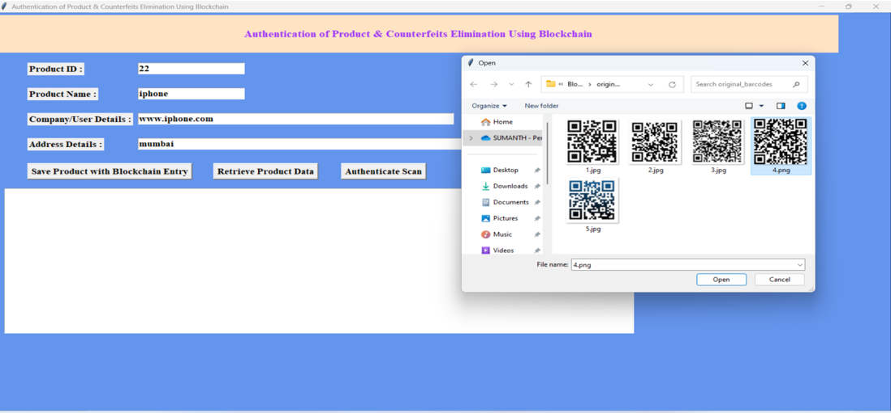
Experiment Results
Save products with blockchain entry:

Slide 11
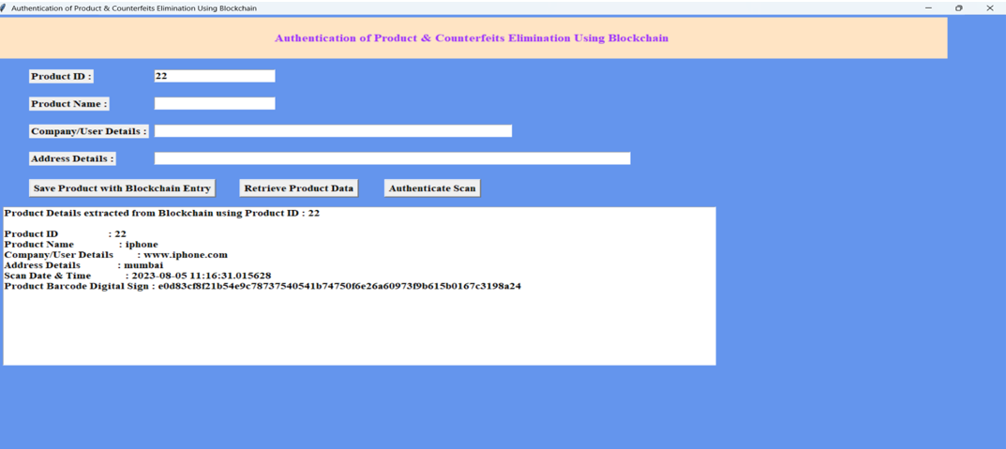
Experiment Results
Retrieve product data:

Slide 12
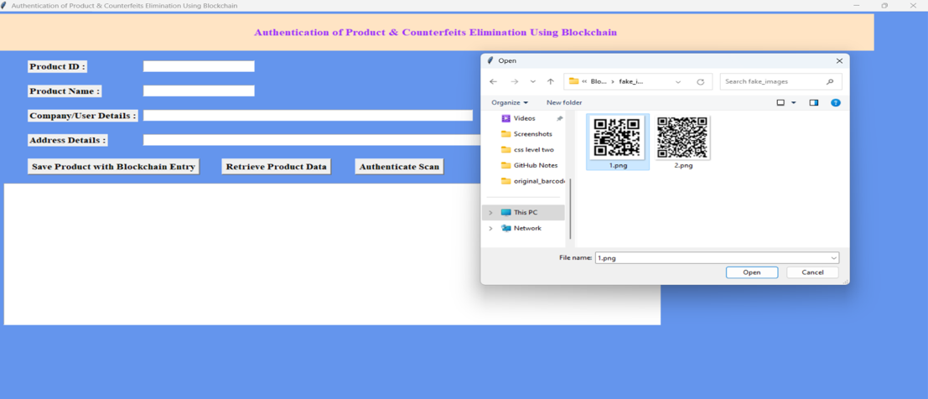
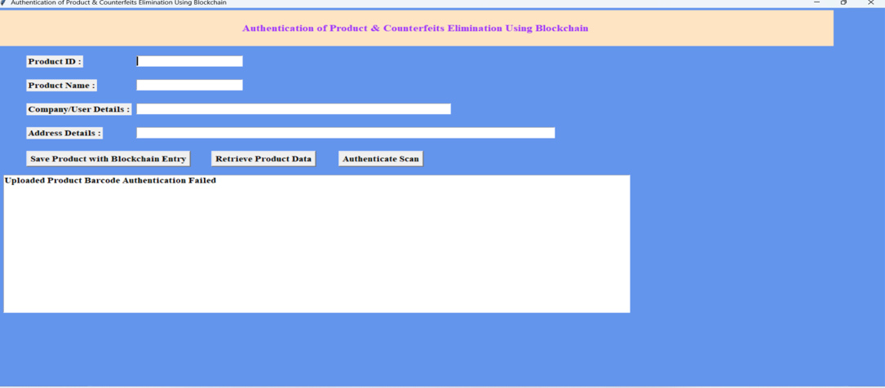
Experiment Results
Uploading fake BARCODE
Authentication Failed

Slide 13
Finding
Product Authentication and Traceability: The system enhances the transparency and traceability of products from manufacturing to the end customer, allowing for easy verification of authenticity and assurance of product quality.
Counterfeit Elimination: The implementation of blockchain technology and unique identifiers such as QR codes linked to blockchain significantly reduces the risk of counterfeit products infiltrating the market.
Resource Efficiency: The system aims to provide a straightforward implementation process with minimal operational costs, ensuring cost-effective and efficient product authentication and tracking.
User Acceptance and Trust: Through enhanced product transparency and authentication, the system aims to build trust between consumers and brands, leading to increased user acceptance and confidence in product genuineness.
Security and Integrity: The use of blockchain technology ensures data integrity through the generation and storage of hash codes of product transactions, contributing to the security and trustworthiness of the system.

Slide 14
Justification
The parameter values improved as a result of the implementation of advanced technology, including blockchain and unique identifiers such as QR codes. This led to enhancements in the transparency, traceability, and security of product authentication processes.
The system's design also aimed at resource efficiency, resulting in lower operational costs and improved efficiency. Additionally, future enhancements were planned to continually improve anti-counterfeiting techniques, indicating a commitment to ongoing advancement.
These improvements collectively contributed to a more secure, transparent, and trustworthy product authentication and anti-counterfeiting system that benefitted both consumers and manufacturers.

